Slide 1
PS Pack Meeting
April 2024

Slide 2
Agenda
E-board reminders
E-board Transitions
Graduation Cord Sale
Icebreaker
Significance of the Pack Program
All-star Spotlight
New Ideas for the Pack Program – We need your help!
Celebrations
Regional Leader Opportunties

Slide 3
E-Board Reminders:
E-Board Transitions:
Please fulfill the 2024-2025 E-Board form (hyperlinked) by Wednesday, May 1, 2024.
Struggling with recruitment?
Inform the campus of elections through campus-wide emailing on your campus event platform (i.e. Engage), or perhaps, your advisor can send a campus-wide email.
Send reminder emails about election application due-dates (send out follow-up/reminder emails); be transparent within these reminder emails about vacancy positions
Include election applications within General/Interest Meeting; set a date for an upcoming General/Interest Meeting to unveil the 2024-2025 e-board; speak with active members about joining and offer time within these meetings for active members to ask questions to the current e-board
Share with fellow friends on campus from various class years and majors; share with student leaders from clubs/organizations that align with the Pack
Notes:
To access hyperlink, please put the slideshow in presenter mode, or copy and paste to browser here: https://forms.office.com/Pages/ResponsePage.aspx?id=CGvJAoQTtEGODsxA-pa8JeT8fHPBduhKm-IevWlfgf5UOUtIVVZCTk1SSUlTMUROUFBYOURPWjdSUy4u

Slide 4
E-Board Reminders:
Graduation Cords:
Purchases must be made no later than Friday, April 5, 2024.
Purchases may made here (hyperlinked).
Ensure that you contact graduating students about this information through email (active members + e-board members), a Messaging platform (to connect with e-board members), and/or within a General Meeting (connecting active members – ensure to review who is an active member within your club through Secretary logs or your campus platform (i.e. Engage).)
Notes:
To access hyperlink, please put the slideshow in presenter mode, or copy and paste to browser here: https://pinkyswear.org/pack-grad-cords?utm_medium=email&_hsmi=298939111&_hsenc=p2ANqtz-8QmGIC37kQMks1UhAGsoZINM3wmDUCgsSJFKIz-M8vvRzkwBQnwJOk1n7Du_5S4WfNUbw428ayXN5Lb2_h0te_462WUlv-8x1x4UXxxhHayFL7PrI&utm_content=298939111&utm_source=hs_email.

Slide 5
Icebreaker – Pinky Swear Storytelling
A story of compassion, collaboration, and celebration
Notes:
Duration: 15 minutes
Groups: 2-3 groups
Objective: Groups are given 10 minutes to study the three images presented on the screen and connect them to a storyline. Ideally, this story will be connected to the Pack, and groups can create existing stories that occurred at events throughout the academic year or make-up a story about a potential future event – what do groups envision about the Pack, and how they would define the Pack impact, specifically within compassion, collaboration, and celebration?

Slide 6
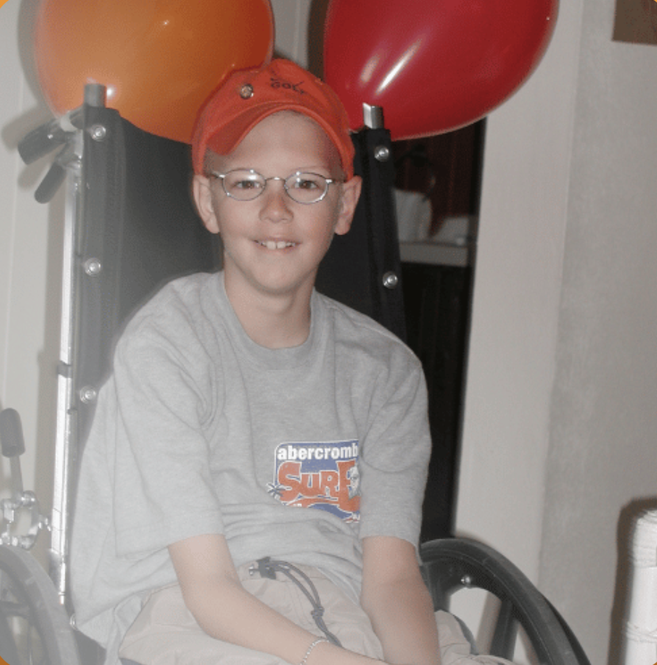
Significance of the Pack Program:
Through campus-wide fundraising, the Foundation has the potential to say “yes” to every family & support Mitch’s legacy by writing on every orange envelope.
“Love Mitch. XOXOXO”
Notes:
You and your campus are the difference for All-Stars and their families. It is with your campus community and network that will enable the Foundation to say “yes” to every family impacted by pediatric cancer and in need of financial and emotional assistance by sharing the Pack program and guiding fundraising efforts.
Share the Values of the Foundation:
Compassion: Share our All-Star and their family’s stories with empathy and sincerity. Be kind and patient with your fellow Pinky Swear Pack members. Remember the Pack mission: helping kids with cancer and their families.
Collaboration: The Pinky Swear community grows evermore when you and your members work together. Furthermore, the Pinky Swear community grows larger by collaborating with your campus community, including different clubs, professional organizations, departments, alumni, local community, etc. Use your networks to share the Pinky Swear Pack mission and for the Foundation to support All-Star families’ immediate needs, facilitate family fun experiences, and alleviate financial obligations of rent, mortgages, car payments, utility bills, groceries, gas, etc.
Celebration: Celebrate success of all sizes within the Pinkly Swear community. You are the leaders that are making strides toward pediatric cancer awareness and supporting All-Stars and their families. Your pinky promise means the world to us. We celebrate your campus everyday, and you should celebrate and honor each milestone that your campus makes for kids with cancer and their families.

Slide 7
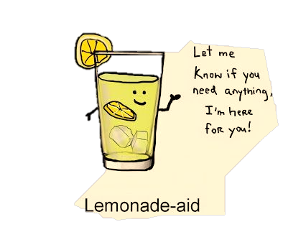
All-Star Spotlight
Diagnosed with T-cell Acute Lymphoblastic Leukemia
4 years old
Star Wars fanatic – loves to roleplay
Azel

Slide 8
Pediatric Cancer Impacts the Entire Family:

Slide 9
Because of your support, we can help All-star Azel & his Family:

Slide 10
New Ideas for the Pack Program:
Fundraising Initiatives:
What kind of fundraising efforts should we try for the last month of the Pack this academic year? Brainstorm ideas and please share with Malaina.Saha@pinkyswear.org and/or Gabriella.DelRio@pinkyswear.org.
Recommended: Strengthen your current fundraisers on campus; both ’Cancer is Messy’ and the Orange Envelope Challenge fundraisers are still active until the end of the semester – how could your Pack strengthen these fundraisers on campus?
Celebrate successes at General/Interest Meetings (reflect) and challenge your campus to a new goal for the current fundraisers – how can you incentivize the campus community?

Slide 11
New Ideas for the Pack Program:
Advocacy On Campus:
What kind of advocacy efforts should Packs maintain on campus?
Remain consistent with communication: send out frequent campus-wide emails about Pack updates (i.e. What is happening on campus to helps kids with cancer and their families?); send monthly campus-wide emails about All-Star spotlights (sharing where fundraising dollars go to); update social media accounts (Provide reminders about campus events/Pack deadlines); and repost photos from the PSF Instagram and PSFPacks Instagram
Collaborate with the campus community: clubs/professional organizations/faculty & staff - collaborate with individuals who can share the Pack mission – it starts with your leadership.

Slide 12
New Ideas for the Pack Program:
Celebrate Successes On Campus:
What kind of celebration are you having on campus to give thanks for your constant support for All-stars and their families?
Celebrate each donor within your ‘Cancer is Messy’ and Orange Envelope Challenge fundraisers thus far – highlight them within a General/Interest Meeting and/or shoutout them on social media platforms
Give thanks – hand-write or digitally print thank you cards to all active members at your campus; purchase club souvenirs through club budget, such as active member pins (Amazon (hyperlinked)), graduation cords (PSF website), sweet treats (Check here for pediatric cancer awareness Hershey kisses (hyperlinked).).
Set up a table/panel within student common area – hand-out thank you notes and PSF merchandise (bracelets & stickers)
Notes:
Please put in presenter mode to view hyperlink or copy and paste to browser:
Pins:
https://www.amazon.com/Fundraising-Cause-Childhood-Cancer-Awareness/dp/B07T74TDLZ/ref=sr_1_1_sspa?crid=5ZAXQ61PCJK9&dib=eyJ2IjoiMSJ9.F8tKGIEuR-jHAI2-VJw9C23mfoMIoAMaJTcP1hKTVXMA7SvoYujSa1MzKBsgPwji_uO-fnpdDsuZ5UGlCycRZee61jdOiWUSIk4rkWQswhuBy2tJ42GE3mjfRaJVz8vfHfEKch0LWSSV2jRuiDw6l-XMq3TZF6xgDv6Ho9voevX57TNApzfxbuRZexZPSC8WCkUMHoAPZ1Vy1yRJsPYSyFSyUqZeJQm5VuZiAMsGVRiJcGeAqJu2IL7oIF5GPpO4f0m8dqi4Nzy0D3PyS0Odh-1dtKB-tB2DozY6_KzrRyY.H_Ke9-uO7MuNEuwIiEtfTnVgiHgd2cjP5htytkRLarM&dib_tag=se&keywords=pediatric%2Bcancer%2Bawareness%2Bpins&qid=1712000229&sprefix=pediatric%2Bcancer%2Bawareness%2Bpins%2Caps%2C81&sr=8-1-spons&sp_csd=d2lkZ2V0TmFtZT1zcF9hdGY&th=1
Hershey Kisses:
https://www.amazon.com/CHILDHOOD-CANCER-AWARENESS-HERSHEY-KISSES/dp/B07ZLV8HC8/ref=sr_1_10?crid=2W1YJEFY7CD2X&dib=eyJ2IjoiMSJ9.106y_qiU8BzRg6qbsW4EIJ036AkX2rzIIdt3tFt2Aba5wJrZEOwEYNYOAFgf2u4omZPK8dmJy6VlaUxvJmgOf_hOWaBigvEurlWGbCoVQH7HLt0UBg14r9SqkayRNyI9sZusnC0VNWuSQg_LrSC0rLdvihBJR-N9v2pW6WWxt6HU-vnbtsWeGwB2EnK542pDomzbGnNE1Mn40g9P-aHl3Yb3dg1fyJZLlzQEa1lFTbrrF-cIyD2bd-AOVfdOswSXqHJG_QmwCCmkZzzl4EM5EjEgbuNLLSSyOagq_xH4Jao.qQKNOOBgsEvlLnKT8pN5M9uRlIEU_hiv_7OE27hvKvM&dib_tag=se&keywords=pediatric+cancer+awareness+hershey+kisses&qid=1712000028&sprefix=pediatric+cancer+awareness+hershey+kisses%2Caps%2C63&sr=8-10.

Slide 13
Regional Leader (RL) Opportunities:
Social Media, Marketing, and Design RL:
Grow our Pack social media presence on Instagram
Ensure the Pack website is updated with current Pack information
Design Pack marketing materials, such as newsletters, flyers, social pages, etc.
Grow our alumni network on LinkedIn
Recruitment & Growth:
Communicating with “inactive” Packs
Identifying campuses to start Packs or reactivate Pack programs
Create events and challenges for Pack program, with a focus on campus recruitment and intercampus recruitment
Support Pack program in recruitment efforts by creating materials to increase membership.
Notes:
Are you interested in being a RL? Connect with Malaina.Saha@pinkyswear.org.

Slide 14
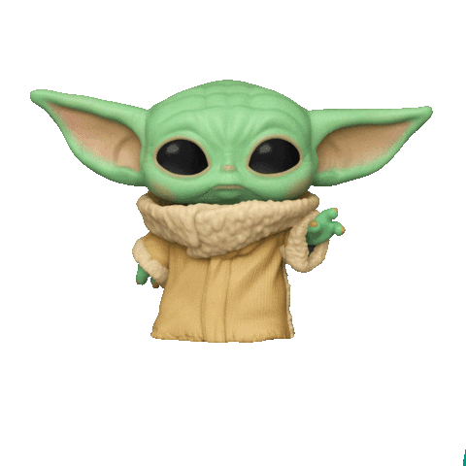
Program Development Regional Leader: Gabriella.DelRio@pinkyswear.org

