Slide 1
PS Pack Meeting
Wishing for sunny days ahead for our All-Stars and their families…
🐝
🐝
March 2024
🐝
🐝

Slide 2
Agenda
E-Board reminders
Icebreaker
Significance of the Pack Program
All-Star Spotlight
Orange Envelope Fundraising Initiatives
Community Engagement/Involvement
Pack Scholarship
Notes:
*Slides 3-4 are meant for e-board members; these are additional resources to consider and evaluate before hosting a general/interest meeting.
*Agenda may be manipulated to add and/or delete certain topics. Before deleting, please read over the resources first.

Slide 3
E-Board Reminders:
E-Board Elections:
Begin thinking about recruitment initiatives for the upcoming academic year (2024-2025).
Will some E-Board members remain, and/or will other positions open-up? Seek confirmation with current e-board members in your next e-board meeting.
Provide a description of available e-board roles in your next general/interest meeting. Initiate discussion between current e-board members and prospective applicants.
Create a Google/Teams Form for available e-board roles for next academic year; set a firm due date on applications.
Send a campus-wide email with Google/Teams Form link for applications; utilize your campus platform, such as Engage to connect with students.
Fill-out the 2024-2025 E-Board Form (hyperlinked) by Wednesday,
May 1, 2024.
Notes:
*If you need assistance on descriptions of e-board roles and/or questions on how to create a Google/Teams Form, please reach out to the regional leader, Gabriella Del Rio, at Gabriella.DelRio@pinkyswear.org.

Slide 4
E-Board Reminders:
Graduation Cords:
On sale until April 5, 2024
$15.00 per graduating students
May be purchased by e-board members/active members who are graduating this semester (Spring 2024); sales typically occur ever March for graduating students of the given semester/year.
Check-in with your e-board regarding who is graduating; review your active members and connect with them to see if they are graduating this semester (via email or general/interest meeting)
Have graduating students fill-out this form (hyperlinked)
Depending on campus budgets for clubs, connect with your Student Engagement coordinator to see if your club budget can cover graduation cords.

Slide 5
Icebreaker Activity: Scavenger Hunt
Duration: 15 minutes
Objective: [input number] of All-Star cards, [input number] of PSF bracelets, and one All-Star story book are hidden.
Find an All-Star card => read the story
Find a bracelet = > wear the bracelet
Find the All-Star story book => read a page from the book
Prizes (optional): orange Starbursts, orange M&Ms, and/or orange Tic Tacs for finding a bracelet or All-Star card; orange Swishmellow, orange tumbler (Stanley, Yeti, etc.), or Amazon gift card
Notes:
Prizes are certainly optional, especially depending on your club’s budget, allocated from your campus. If prizes are provided, the ideas above are mainly orange to remain in spirit of the Orange Envelope Challenge and to keep participants motivated and excited about the challenge throughout March.

Slide 6
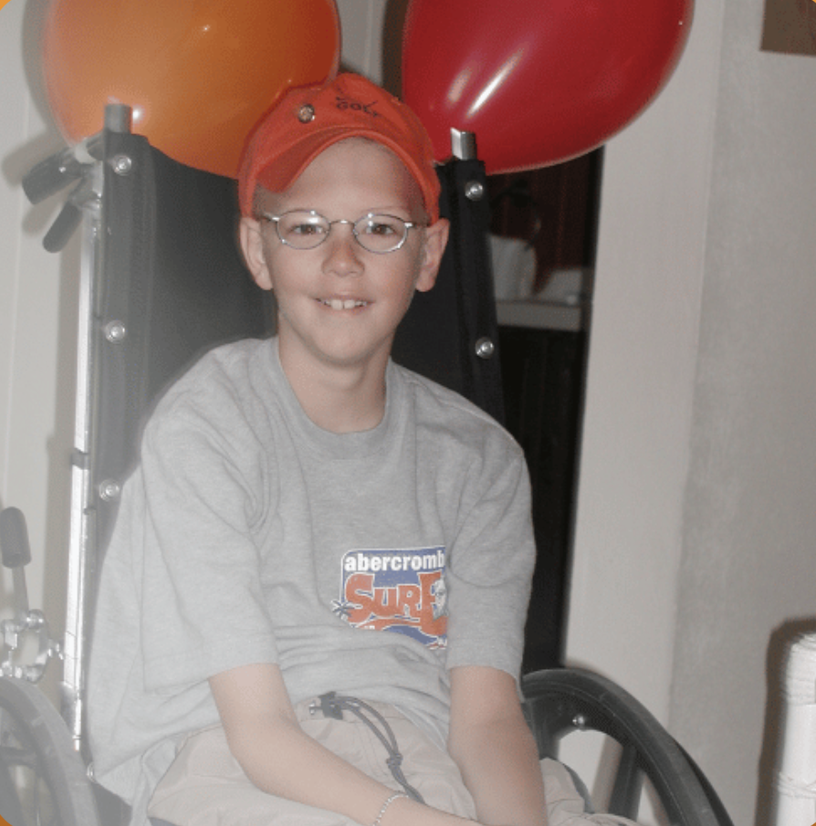
Significance of the Pack Program:
Through campus-wide fundraising, the Foundation has the potential to say “yes” to every family & support Mitch’s legacy by writing on every orange envelope.
“Love Mitch. XOXOXO”
🐝
🐝
Shedding light into kids with cancer and their family’s lives…
Notes:
You and your campus are the difference for All-Stars and their families. It is with your campus community and network that will enable the Foundation to say “yes” to every family impacted by pediatric cancer and in need of financial and emotional assistance by sharing the Pack program and guiding fundraising efforts.
Share the Values of the Foundation:
Compassion: Share our All-Star and their family’s stories with empathy and sincerity. Be kind and patient with your fellow Pinky Swear Pack members. Remember the Pack mission: helping kids with cancer and their families.
Collaboration: The Pinky Swear community grows evermore when you and your members work together. Furthermore, the Pinky Swear community grows larger by collaborating with your campus community, including different clubs, professional organizations, departments, alumni, local community, etc. Use your networks to share the Pinky Swear Pack mission and for the Foundation to support All-Star families’ immediate needs, facilitate family fun experiences, and alleviate financial obligations of rent, mortgages, car payments, utility bills, groceries, gas, etc.
Celebration: Celebrate success of all sizes within the Pinkly Swear community. You are the leaders that are making strides toward pediatric cancer awareness and supporting All-Stars and their families. Your pinky promise means the world to us. We celebrate your campus everyday, and you should celebrate and honor each milestone that your campus makes for kids with cancer and their families.

Slide 7
All-Star Spotlight: March
Diagnosed with T-cell Acute Lymphoblastic Leukemia
4 years old
Star Wars fanatic – loves to roleplay
🐝
🐝
🐝
May the force be with you and your family, Azel.
🐝
🐝
🐝
🐝
🐝
🐝
Azel
🐝
🐝
🐝
🐝
🐝
🐝

Slide 8
Azel’s Story:
The PSF is dedicated to helping kids with cancer and their families emotionally and financially:
“The prognosis led us into a position of complete vulnerability, and with an 85 percent survival rate, I wondered if my child would make it through. I had an immense feeling of grief right away.”
~Abigail (Azel’s mom)
Abigail used the Family and Medical Leave Act (FMLA), from her position as a musical elementary school teacher, to be there for Azel, and Darnell (Azel’s dad) had lost his job at a non-for-profit organization. Both parents were alongside Azel’s medical journey, dedicated and faithful in him and his recovery.
Azel developed diabetes during the induction phase of his treatment, due to the steroids, and he is currently no longer a diabetic but is underweight and on an appetite stimulant.
PSF helped Azel’s family with an Orange Envelope. Abigail described that the PSF application was easy to fill-out, and the gift card was spent in Walmart for groceries.
“It feels like you are in a different community of support.”
~Abigail

Slide 9
Azel’s Story: Resilient and Adaptable

Slide 10
Orange Envelope Challenge:
Orange Envelope Challenge Checklist:
Post your team fundraiser on your campus event platform
Share your team fundraiser on social media, and challenge 10 users to donate $25.00
Share your team fundraiser with family/friends; text 10 people, and challenge them to donate $25.00 each
Send a campus wide email on your campus event platform; challenge students to assist with fundraising efforts for your Pack
Challenge alumni via social media to participate and spread the Orange Envelope Challenge
Share with local sponsors (i.e. local businesses)/campus community (i.e. faculty)
Maintain connections via social media, messaging, and emails – check-in on progression and maintain your digital presence regarding the Orange Envelope Challenge
Bonuses:
Throw an Orange Fundraising Party
Collaborate with your sports team on campus; host an orange-themed game and fundraise via concessions, raffles, entry fees, etc.
🐝
🐝
🐝
🐝
🐝
🐝
Notes:
* Any items that have not been checked within the checklist should be your Pack’s next initiative – the secondary list is composed of bonuses/additional ideas.

Slide 11
Orange Envelope Challenge:
Celebrate each milestone:
Host a general/interest meeting, highlighting your Pack’s successes during the Challenge; share information provided by Fundraise Up – team goal progression; donors from different areas; page visits; total donations; etc.
Expand your digital presence – create a video, thanking participants during the challenge; create a collage of photos during events, directed toward the Challenge AND/OR highlight your biggest contributor, whether that be a donor and/or Pack member
Host an active Pack membership event – celebrate all your active Pack members throughout the Orange Envelope Challenge through an engaging event, such as a Paint & Sip (non-alcoholic), movie night, grab and go (goodie bags), etc.
🐝
🐝
🐝
🐝
🐝
🐝

Slide 12
Community Involvement/Engagement:
Starbucks:
We can receive money from Starbucks to assist our All-Stars and their families, but we need your help!
All you have to do is provide a letter, provided by the PSF, to your local Starbucks store(s).
Please email Malaina.Saha@pinkyswear.org, if you are interested. This is such a simple way to raise money for our All-Stars and their families.
Letters of Encouragement (LOE) Tabling Event:
Set-up a LOE tabling event within your campus community or within your local community
Ask local businesses to support this event and tell them why – the PSF mission; set a date, create a poster about the Pack, bring PSF bracelets and All-Star cards, as well as prompt community members to make cards for kids with cancer (Provide a printed copy LOE guidelines).
🐝
🐝
🐝
🐝
🐝
🐝
Notes:
If you need assistance with asking local businesses and/or need more All-Star cards/bracelets, feel free to connect with Malaina.Saha@pinkyswear.org.

Slide 13
Final Announcement: The Pack Scholarship is extended until Monday, March 25, 2024!
🐝
🐝
🐝
🐝
🐝
🐝

Slide 14
Program Development Regional Leader: Gabriella.DelRio@pinkyswear.org

