Slide 1
PINKY SWEAR FOUNDATION
Pack Meeting
January 2024
Notes:
1 hour-long meeting

Slide 2
AGENDA
E-Board Introductions
Ice breaker game
Pinky Swear Foundation (PSF) Mission
All-Star Spotlight
What do YOU want to get out of Pack this semester?
The Orange Envelope Challenge
Notes:
1 min: Welcome everyone to the meeting! Run through the agenda for the night. Add/delete what you need for your group!

Slide 3
Meet the leader’s making strides toward pediatric cancer awareness:
2024 Spring Semester E-Board:
Insert Name
Insert Name
Insert Name
Insert Name
E-Board Roles
E-Board Roles
Insert Name
Insert Name
Insert Name
Insert Name
E-Board Roles
E-Board Roles
Notes:
Introduce the E-Board! Include pictures of each e-board member in the white squares within the picture frame. You may paste and fit as needed. You can delete additional picture frames as needed or copy and paste them for more e-board members. This is to serve as a template. Feel free to change around and be as creative as you would like. This slide is meant to serve as a more interpersonal approach for attendees to get to know you more, and why you joined the Pack.
E-Board members can introduce themselves.
Explain why you joined the Pack. It is important to share your ‘why’ to help you remember the importance of the Pack program to you, and your ‘why’ can inspire others to join the Pack.

Slide 4
Ice Breaker Activity: Trivia
Objective: To get teams to work together, learn each others' names, and answer fun questions
Duration: 10 to 15 minutes
Prize: insert here
QR Code:
Notes:
Create a free Kahoot or Poll Everywhere account to create fun Trivia questions: Kahoot: https://kahoot.com (Copy and Paste to browser.) OR Poll Everywhere: https://www.polleverywhere.com/ (Copy and Paste to browser.)
Make sure to explore the website first and see how it works. Kahoot has a limited number of entrees for free subscription (around 10 players). Poll Everywhere is not as limited and more open. Please plan ahead of time.
Generate your own Trivia questions, depending on your desired theme. Share QR Code on slideshow.
When the ready, gather individuals into smaller groups. Ensure that everyone introduces themselves to each other first. One person scans the code, and the group picks a name to display.
Start the game! The group that wins can receive candy (can never go wrong with goodies) and/or get a shoutout on the Pack Instagram. Make sure to take pictures of everyone, sharing an exciting, celebratory way of spreading the Pack mission on campus.

Slide 5
Significance of the Pack Program:
Mission:
Celebration
Compassion
Collaboration
Helping kids with cancer (denoted as “All-Stars” at the Foundation) and their families with financial and emotional support while simultaneously creating a close-knit community of students across campuses.
Vision For the Foundation:
Three Cs of Success:
To say “Yes” to every family, and we help support this vision through fundraising.
Notes:
It is important to treat every General/Interest Meeting with the idea that not every attendee knows about the Pinky Swear Foundation (PSF). Even more so, it is important to remind current followers of the Pack mission and vision of the foundation. It reminds members of why their doing what they are doing. Further, with every single step that your Pack takes, remember to celebrate one another’s success on campus, big or small, have compassion for others and the work that you are doing for All-Stars and their families, especially when hearing stories, and collaborate with the PSF, regional leaders, and other on-campus clubs to help support the Pack mission and expand the program at your campus. Let’s reinforce our close-knit community and open it up to others at your campus to join! ☺

Slide 6
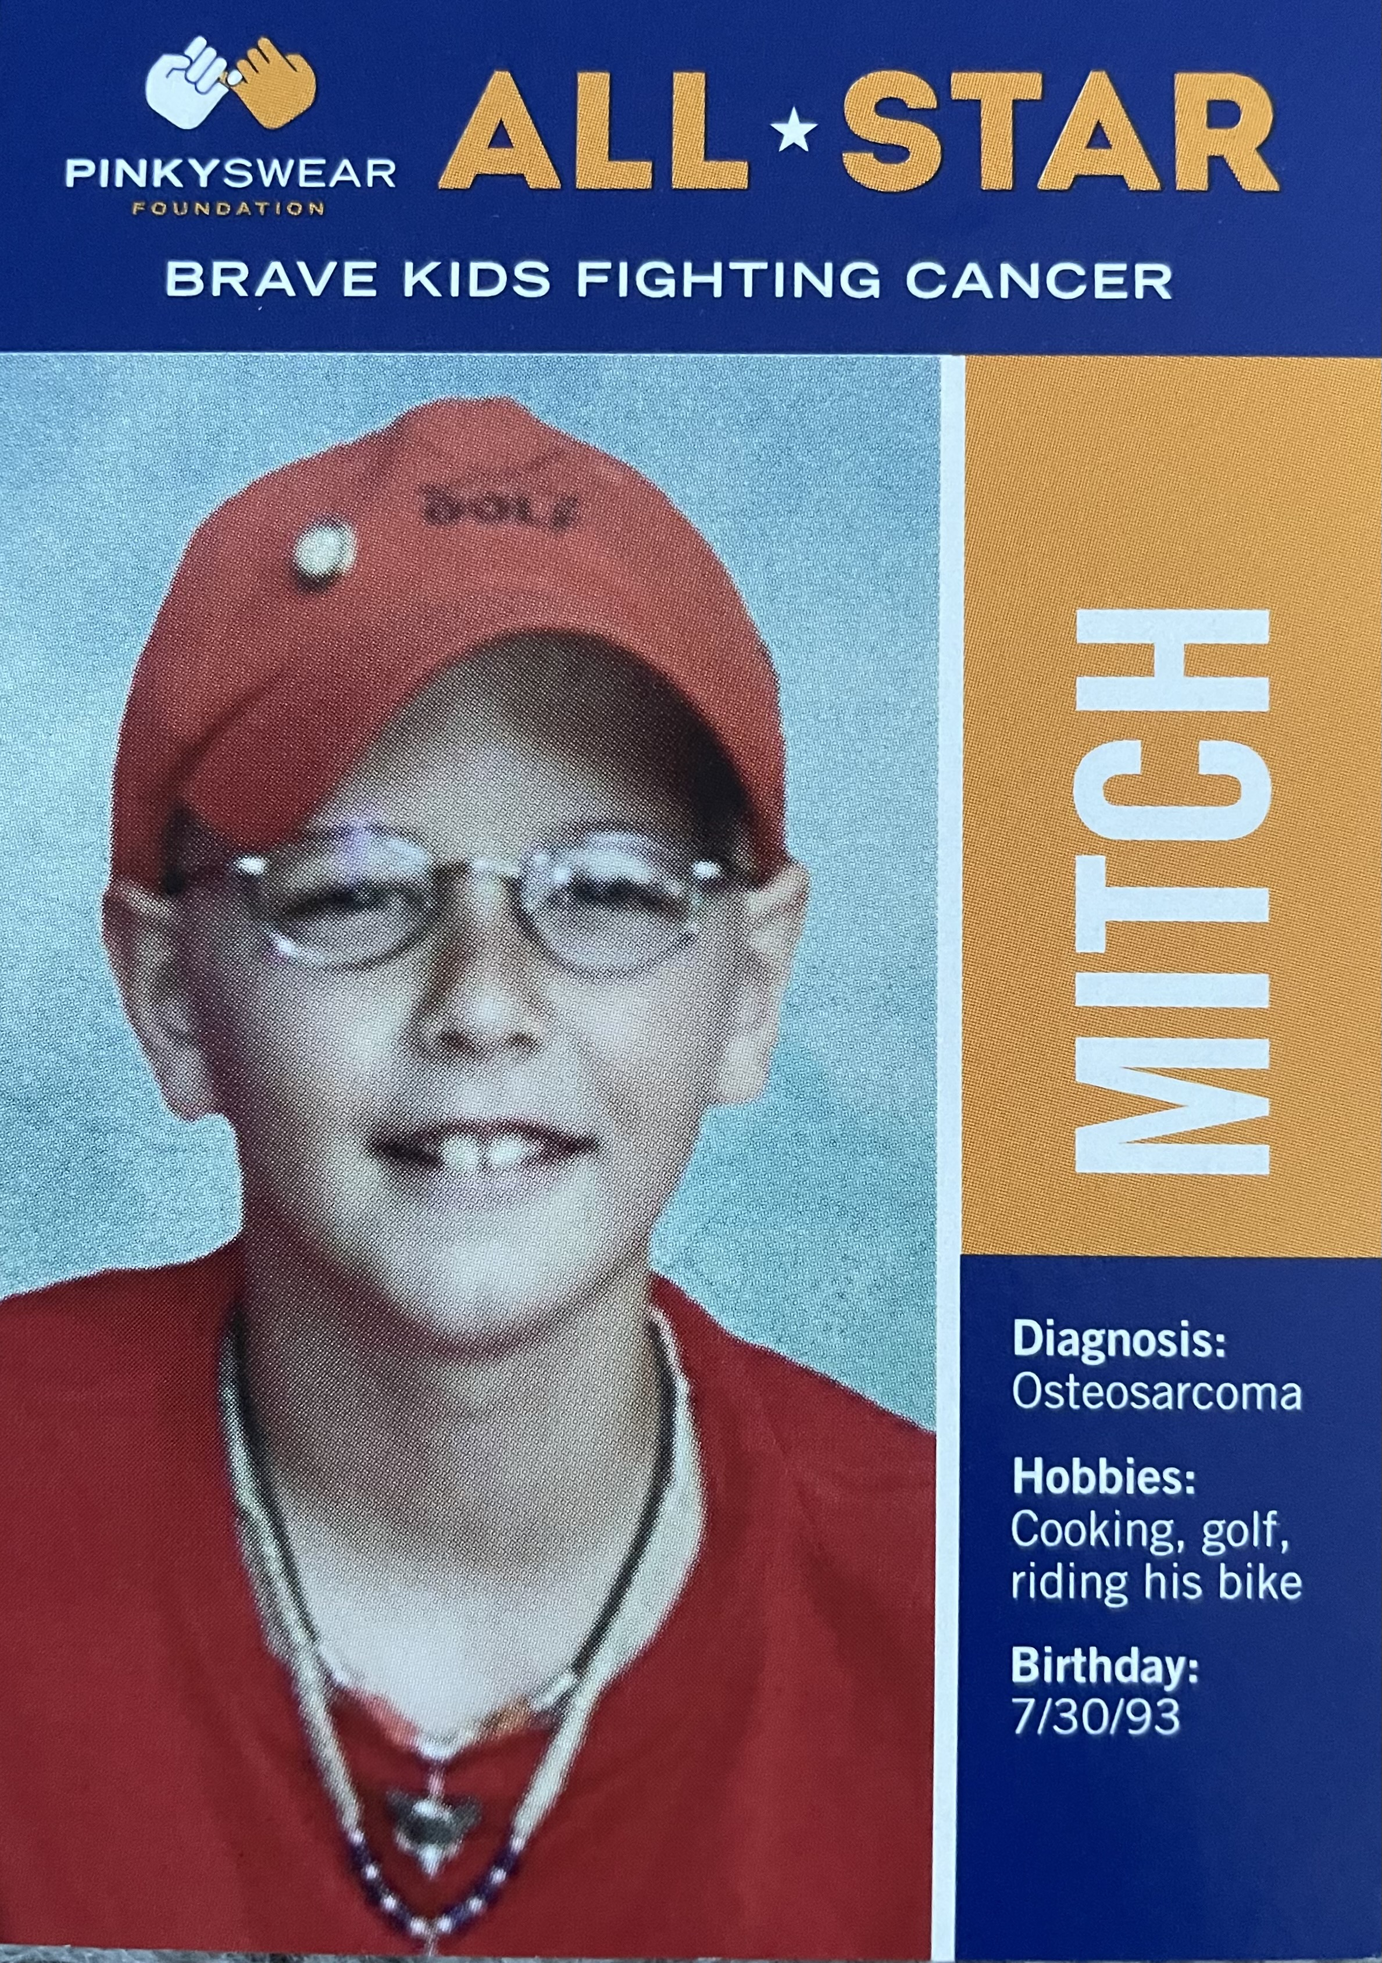
Where it all began: All-Star Mitch’s Story
Each month, All-Star children get to tell their story. It began with nine-year old Mitch, who made a pinky swear promise to his dad to help children with cancer and their families before his passing of osteosarcoma. Help us spread these All-star stories, in honor of pediatric cancer awareness, and live out Mitch’s legacy.
Notes:
It is extremely important to take on every General or Interest Meeting with the idea that not every attendee knows about the Pinky Swear Foundation (PSF) and its origination. It is important to share its originations and share why we do what we do- that is, to relieve families of financial stress and in honor of Mitch, to put “Love Mitch, XOXOXO” to every family burdened by pediatric cancer and in need of assistance. Pediatric cancer impacts the entire family, and to ease financial and emotional burdens, the PSF supports immediate needs, facilitates family fun experiences, and alleviates financial obligations of rent, mortgages, car payments, utility bills, groceries, gas, and more.

Slide 7
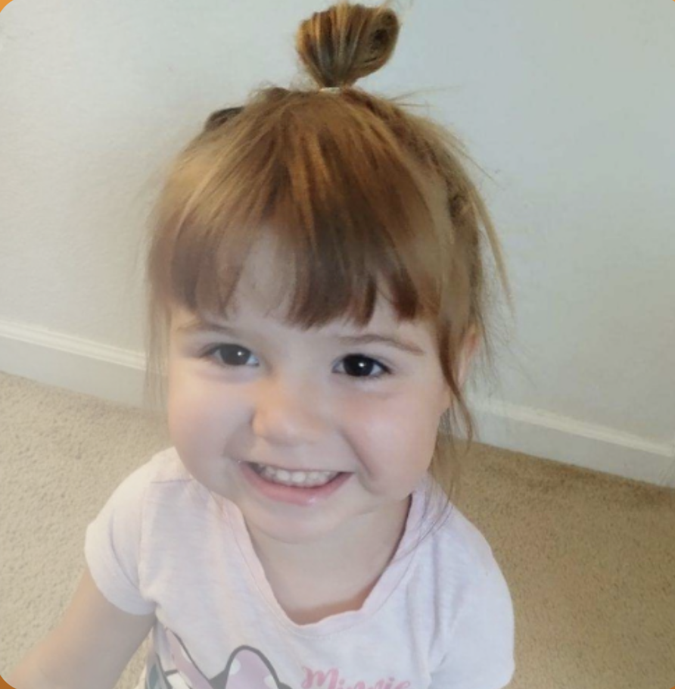
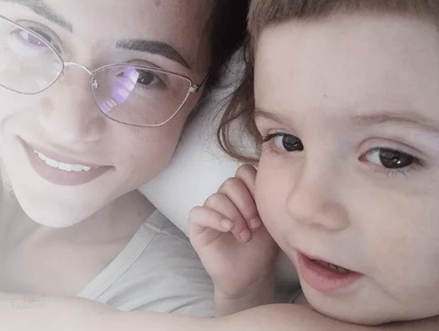
All-Star January Spotlight: Lilyana
Three-year old, Lilyana, diagnosed with acute myeloid leukemia in May of 2023
Lilyana’s diagnosis brought feelings of shock, scaredness, deep sadness, worriedness, and powerlessness to the family. Her specific diagnosis is the worst type of leukemia, where it is resistant to treatment and very rare. At one point, Lilyana spent 90 days in the hospital for care, causing the parents to take off from work and focus on her care. Thereafter, financial stress became a burden for the family.
Despite her diagnosis, Lilyana is highly curious, social, talkative, energetic, and affectionate.
Lilyana’s mom, Aida, and her dad, Eric, took off from work to care for Aida.
The family is expecting another child.
*PSF Impact: The family received an Orange Envelope from the Pinky Swear Foundation (PSF) after Lilyana’s diagnosis. “We used the gift cards mainly for the gas that we needed to drive back and forth to San Francisco. There was also a little note for Lily that she liked.” The PSF also paid the family’s mortgage in January, enabling the parents to focus on Lilyana’s care and provide financial relief.
Notes:
It is important to learn about Lilyana’s story and convey the PSF’s impact on the family. This helps students learn more about how vital their support is, and how significant the Pack program is in fundraising and spreading these stories. No family should ever have to decide between work and caring for their children. With the support of the Pack program, it enables the PSF to support families financially and enable the family to focus on the All-Star.

Slide 8
Making the best of the semester
Notes:
10 min

Slide 9
The 6-word story

Slide 10
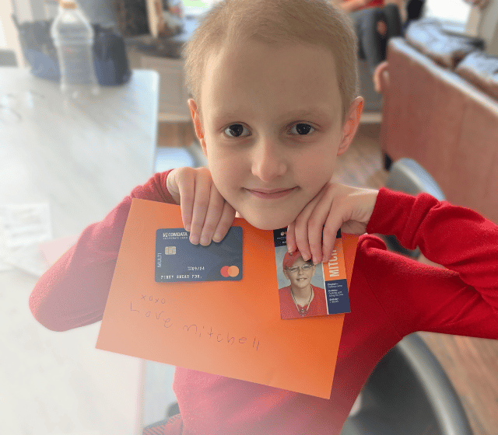
The Orange Envelope Challenge
Fill an orange envelope with $250 by fundraising
"Within six months of a child's diagnosis, the Orange Envelope program provides timely assistance, including a gift card, heartfelt letters of encouragement, and a warm welcome to the Pinky Swear community."
When each Pack member participates, we have the potential to raise more than $100,000.
Notes:
What: The OE Challenge is this years Spring Fundraising campaign for Pinky Swear
Fill an orange envelope with $250 by fundraising*! #HopeInAnEnvelope
Why: "Within six months of a child's diagnosis, the Orange Envelope program provides timely assistance, including a gift card, heartfelt letters of encouragement, and a warm welcome to the Pinky Swear community." by taking on this challenge, you will be able to directly support one newly diagnosed family by sponsoring their orange envelope.
When: Feb and Mar 2024
Get Started!
Set up your individual fundraising page
Use our Amazon Storefront to purchase your envelopes
Start Fundraising!
Start thinking of ways that you can fundraise as an individual to get your envelope filled!

Slide 11
UPCOMING
Next meeting: (insert date)
Share social media posts!
Follow PSF on Social (ADD ACCOUNTS)
Notes:
2 min: Tailor to your group's needs!

Slide 12
PINKY SWEAR FOUNDATION
Thank you!
PINKIES UP!
Notes:
Thank everyone for coming!

