Slide 1
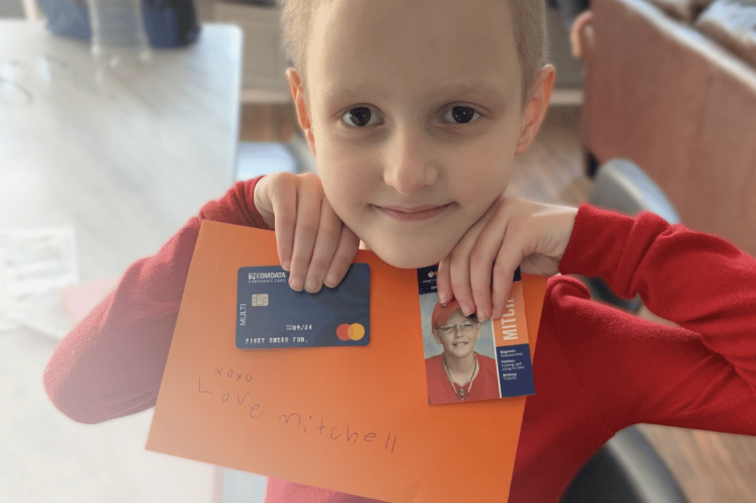
PS Pack Meeting
February 2024
“Love Mitch. XOXOXO”

Slide 2
Agenda
E-Board reminders
Icebreaker
Significance of the Pack Program
All-Star Spotlight
Orange Envelope Fundraising Initiatives
Letters of Encouragement (LOE) Reminders
Choose an All-Star
Foundation Updates for Collegiate Pinky Swear Community
Notes:
*Slides 3-5 are meant for e-board members; these are additional resources to consider and evaluate before hosting a General/Interest.
*Agenda may be manipulated to add and/or delete certain topics. Before deleting, please read over the resources first.

Slide 3
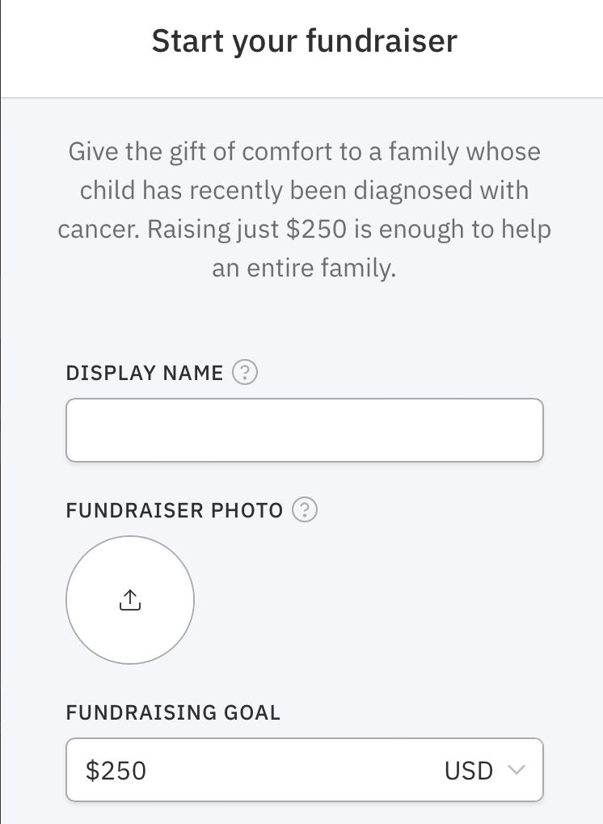
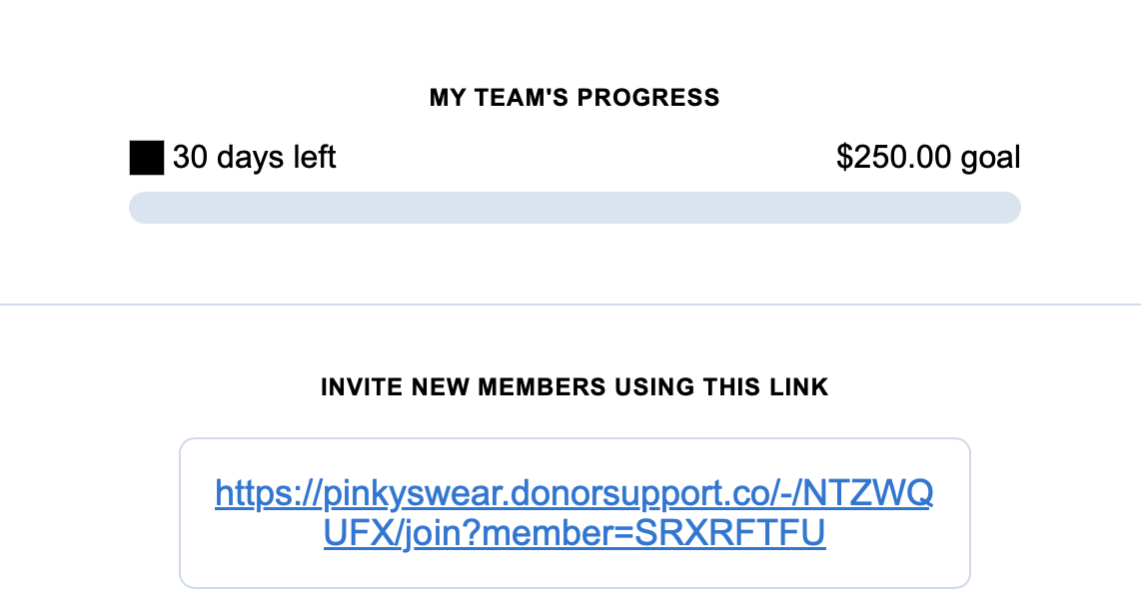
E-Board Reminders:
Orange Envelope Challenge (February – March 2024):
Scan the QR code, and sign-up your Pack.
Input your Pack’s name, followed by ‘Spring 2024.’
Invite Pack members to join the team via the link.
Notes:
Click on ”Orange Envelope Challenge,” as it will bring you to an informative page regarding fundraising information, allocation, and steps to sign-up, as well as take action.
Quick Overview of How to Sign-Up:
Scan QR Code.
Insert Pack name, followed by ‘Spring 2024’ to denote the time/year of Pack activity.
Ex. If I was Albany College of Pharmacy and Health Sciences’s Pack (ACPHS), I would display “ACPHS PS Pack Spring 2024.”
3. Once you have created your team fundraiser, an email will be sent to you. Ensure that you ‘flag’ or ‘star’ this email, so you can easily refer to it at any point, especially to check team progression. Once you scroll to the bottom, there will be a unique link for your team to allow new members to sign-up. Share this link with your fellow Pack members for them to join under your Pack.

Slide 4
E-Board Reminders Continued:
Celebration
Compassion
Collaboration
Pack Pulse Meetings:
Tuesday, February 6, 2024, at 12:00p.m. (CST)
Wednesday, February 7, 2024, at 5:00p.m. (CST)
Tuesday, March 5, 2024, at 12:00p.m. (CST)
Wednesday, March 6, 2024, at 5:00p.m. (CST)
Requirements:
Presidents and/or Vice Presidents must attend one Pack Pulse Meeting each month.
Stay in the loop with other Packs.
Notes:
Zoom links and sign-ups will be sent via email. The first two meetings include a Zoom link within February.
*These Pack Pulse meetings allow us to commit to our values as a foundation: be compassionate with one another, solidifying our close-knit community; collaborate with each other across different campuses and learn from one another; and celebrate each other’s successes. Each of you have a duty to uphold these values, hence the required attendance for at least one Pack Pulse meeting each month.

Slide 5
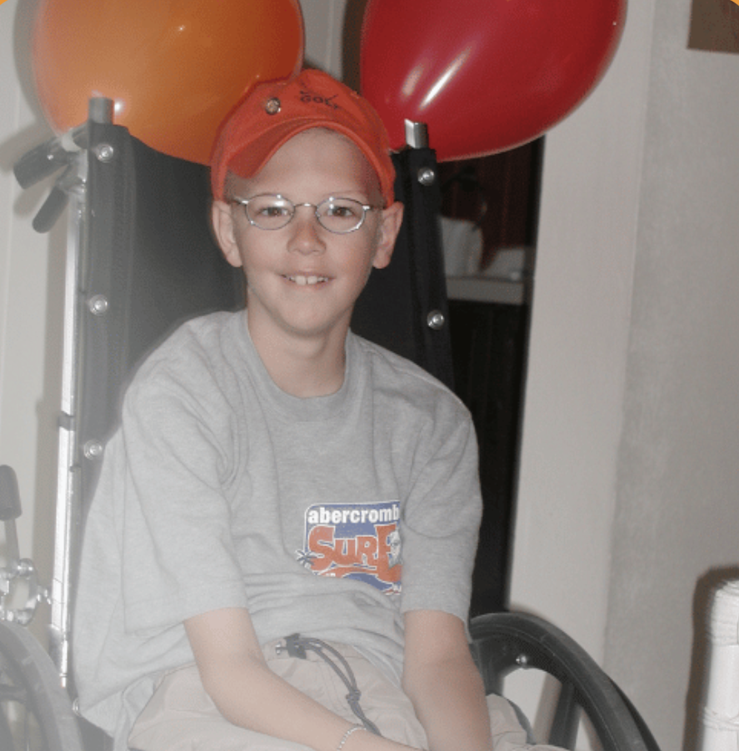
E-Board Reminders Continued:
All-Star Experiences:
This semester, Packs will not be meeting with a specific All-Star, due to cost restrictions.
Instead, Packs will be picking a specific All-Star and dedicate their fundraising efforts within the Orange Envelope fundraiser toward the chosen All-Star and their family.
Share your chosen All-Star’s story when engaging with prospective donors. Center the Orange Envelope Challenge around your chosen All-Star’s story, reflecting some of the experiences that families undergo when a child has cancer. Pediatric cancer impacts the entire family.
Notes:
Please refer to slide 13 for more information. Slide 13 can be a potential slide within an Interest/General Meeting to engage the audience in selecting a specific All-Star story together.

Slide 6
Icebreaker Activity: Two Truths & One Lie – Pinky Swear Edition
Duration: 15 minutes
Groups: 3-4 individuals
Objective:
Explore the Pinky Swear Foundation (PSF) website for five minutes within your groups.
Pick two facts from the website (truths) and create one lie (misconstrue a fact), based on the PSF website (Duration: 5 minutes).
Each group must decide the other group’s two truths and a lie – test your knowledge about the PSF (Duration: 5 minutes)!
Prize(s): PSF merchandise (Mitch card; PSF bracelet; yellow ribbon, etc.)
Notes:
This activity offers a great way for attendees to familiarize themselves with the website and interact with it. Further, it allows them to test their knowledge about the PSF and learn new things! It is always exciting to provide a prize to attendees for their participation. Examples are listed but are not limited. Feel free to manipulate the slide to your liking, depending on the group size.
*Please click on the “Pinky Swear Foundation (PSF) website” to be directed to the website.

Slide 7
Significance of the Pack Program:
Through campus-wide fundraising, the Foundation has the potential to say “yes” to every family & support Mitch’s legacy by writing on every orange envelope.
“Love Mitch. XOXOXO”
Notes:
You and your campus are the difference for All-Stars and their families. It is with your campus community and network that will enable the Foundation to say “yes” to every family impacted by pediatric cancer and in need of financial and emotional assistance by sharing the Pack program and guiding fundraising efforts.
Share the Values of the Foundation:
Compassion: Share our All-Star and their family’s stories with empathy and sincerity. Be kind and patient with your fellow Pinky Swear Pack members. Remember the Pack mission: helping kids with cancer and their families.
Collaboration: The Pinky Swear community grows evermore when you and your members work together. Furthermore, the Pinky Swear community grows larger by collaborating with your campus community, including different clubs, professional organizations, departments, alumni, etc. Use your networks to share the Pinky Swear Pack mission and for the Foundation to support All-Star families’ immediate needs, facilitate family fun experiences, and alleviate financial obligations of rent, mortgages, car payments, utility bills, groceries, gas, etc.
Celebration: Celebrate success of all sizes within the Pinkly Swear community. You are the leaders in making strides toward pediatric cancer awareness and supporting All-Stars and their families. Your pinky promise means the world to us. We celebrate your campus everyday, and you should celebrate and honor each milestone that your campus makes for kids with cancer and their families.

Slide 8
All-Star Spotlight: February
Montana
Diagnosed with Acute Lymphoblastic Leukemia
7 years old
Eli was just a kid who rode horses, and within a matter of hours, he was on a ventilator and had numerous surgeries.
Seattle
February 1, 2024
(Last infusion)
Eli
Notes:
Please share Eli’s story with compassion. Please do not forget to mention that Eli’s last infusion was February 1st. Please celebrate the journey that both himself and his family have overcome. To better days for Eli and his family….
*Please click on “All-Star Spotlight: February” to be directed to Eli’s story.

Slide 9
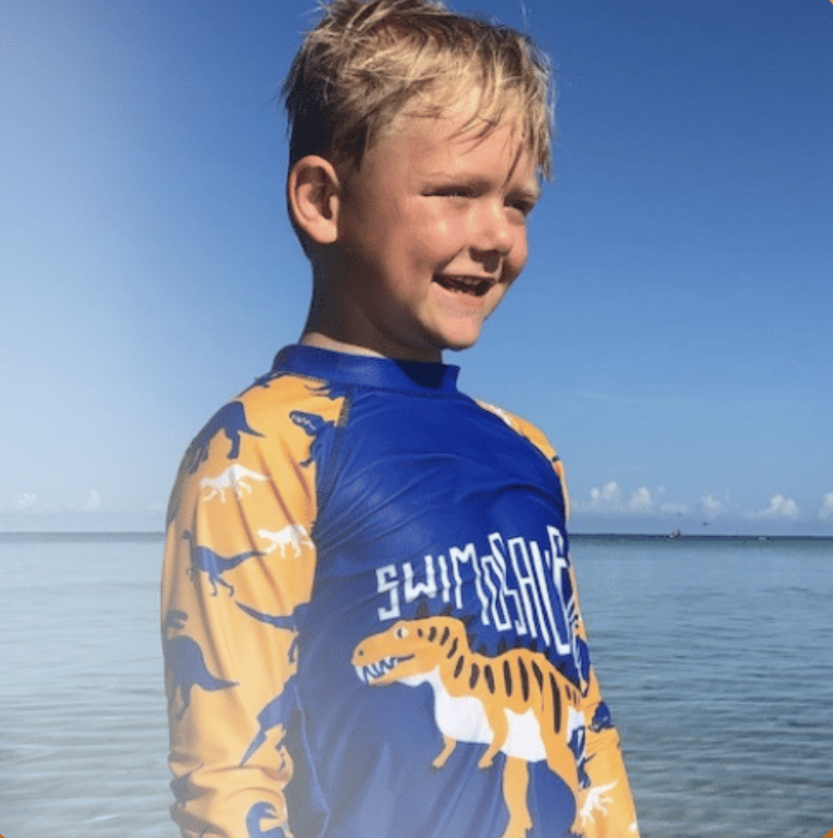
PSF Impact On All-Star Eli:
”This is lymphoma. We need to life-flight him to a children’s hospital now.”
One of the most difficult things that a parent can hear – that their child has cancer.
Tom (Eli’s father) owned a business, and Kira (Eli’s mother) was a massage therapist. After Eli’s diagnosis, Kira and Tom were fearful of shutting the business, and Kira was not working. Financial obligations were a burden, amid Eli’s treatments. The family needed to solely focus on Eli. He received treatment in Seattle, although the family lived in Montana. They were facing additional expenses for travel.
PSF sent an Orange Envelope, including gift cards and donations. Additionally, $500.00 was allocated to the family and used for gas, food, and additional items for Eli. Eli faces regular chemo and lumbar punctures. He also faced intense treatments, including intramuscular injections in his legs that caused immense nausea. Eli became sick again after a period of six weeks, where the PSF provided a grant to assist with mortgage expenses.
Notes:
Please share Eli’s story with compassion. Your Pack has the ability to fundraise for All-Stars like Eli through various initiatives, including the Orange Envelope challenge, and make a Pinky Swear impact for these families. Eli’s story is one of the many stories that indicate that pediatric cancer impacts the entire family.

Slide 10
Orange Envelope Challenge – Fundraising Initiatives:
“Love Mitch. XOXOXO”
Orange Envelope Fundraiser:
How to Gather Donations:
Share your team fundraiser with your campus; fulfill a fundraising flyer on campus and post to your campus event platform (Ex. Engage)
Share your team fundraiser on social media. Challenge 10 users to donate $25.00 for a chance to win a prize (Ex. Orange Stanley cup; orange Swishmellow; Amazon gift cards, etc.)/ send out a campus wide challenge
Speak with local businesses/on-campus departments to donate items to your club that you can sell
Coordinate with your on-campus dining hall; on a given dining night, proceeds will be dedicated to the fundraiser, or perhaps, food may be donated for an event
Throw an Orange Party on campus to raise money for kids with cancer
Coordinate with other departments on campus to increase participation, such as the department of student engagement/affairs
Host a party within school gymnasium to include music/space to dance
Admission fee: $2.00 - $5.00 per person
Notes:
*Please click on the “Orange Envelope Fundraiser” to engage with a link that provides further information about the Orange Envelope challenge (Included on the Pack Headquarters website and January’s President Meeting).
Quick Overview of the Orange Envelope Challenge:
The PSF provides families and their All-Star who are newly diagnosed with an Orange Envelope, filled with $200.00 gift card, heartfelt letters of encouragement, and a warm welcome to the Pinky Swear community. The Foundation has the opportunity to say “yes” to every family who requests an Orange Envelope by your Pack facilitating a $250.00 fundraiser (Duration: February – March 2024). Together, we can honor Mitch’s legacy of helping kids with cancer and their families, along with writing his words of honor: “Love Mitch. XOXOXO.”
*You can fulfill more than one of these ideas – this will enable your Pack fundraiser to grow evermore on campus. Ensure that all your Pack members share the team fundraiser with their friends/family/professors/administration. You are a representative of your club, so share the message and advocate for financial and emotional support for families impacted by pediatric cancer. It all starts with sharing with one another. If you are involved in other clubs/professional organization, think about ways in which they can help facilitate the Pack and vice-versa, along with sharing with other members within different clubs/professional organizations.

Slide 11
Letters of Encouragement Reminders:
Letters of Encouragement Guidelines:
Coordinate an envelope decorating party while simultaneously writing letters of encouragement
Envelopes can be orange-themed, dedicated to the Orange Envelope Challenge. Resources, such as orange construction paper or purchasing orange envelopes on Amazon, are recommended to put letters within and fundraising dollars.
Consider sharing the Donations For Cards page to cover package costs.
Accept digital cards too (can be emailed to Malaina.Saha@pinkyswear.org)
This will help promote virtual donations. You can utilize this photo on a fundraising page or Venmo.
Notes:
*Please click on “Letters of Encouragement Guidelines” to be directed to the resource material. It is recommended that this is displayed during the event for all attendees to view. For virtual cards, this can be shared via email or inspected by Pack members to ensure that these guidelines are met.
*Please click on “Amazon” to be directed to recommended orange envelopes for purchase.
*All physical cards may be mailed to 5555 W. 78th St., Suite E, Edina, MN 55439. Please click on the “Donations For Cards page” to acquire the link to share with your networks.
*Please click on “photo” to display a virtual photo for the Orange Envelope challenge to be used on a fundraising page or Venmo.

Slide 12
Letters of Encouragement Examples:
Notes:
*For more examples, please review pun encouragement cards (Copy and paste link to browser.). https://www.google.com/search?sca_esv=574911510&rlz=1C1GCEA_enUS1070US1070&sxsrf=AM9HkKm75dQjBPtKPnMpX9NB11_0PTaXyA:1697739962696&q=pun+encouragement+cards&tbm=isch&source=lnms&sa=X&ved=2ahUKEwivyZab3oKCAxXyrokEHeMyB4AQ0pQJegQIDRAB&biw=1280&bih=563&dpr=1.5

Slide 13
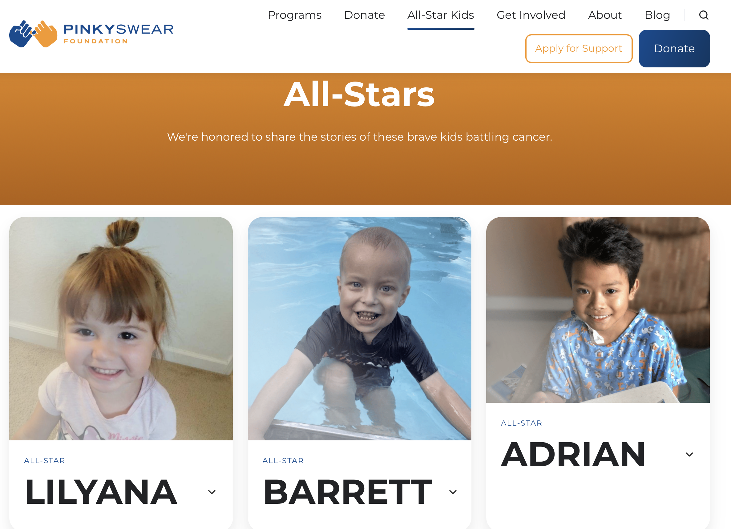
Choosing An All-Star:
All-Star Kids:
Notes:
Interact with the “All-Star Kids” title, which will direct you to the website.
Look through the website with your Pack. Choose an All-Star with your Pack and read their story.
Dedicate your fundraising efforts in honor of your chosen All-Star. Learn their story and share their story with donors, relaying the impact that pediatric cancer has on the child and the family, as well as the PSF impact for the family (where the dollars are going to and supporting).

Slide 14
Foundation Updates For the Pack:
PSF Scholarship: Opens Monday, February 19, 2024
Expectation: three winners only
Winners are chosen, based on participation, fundraising, and leadership.

Slide 15
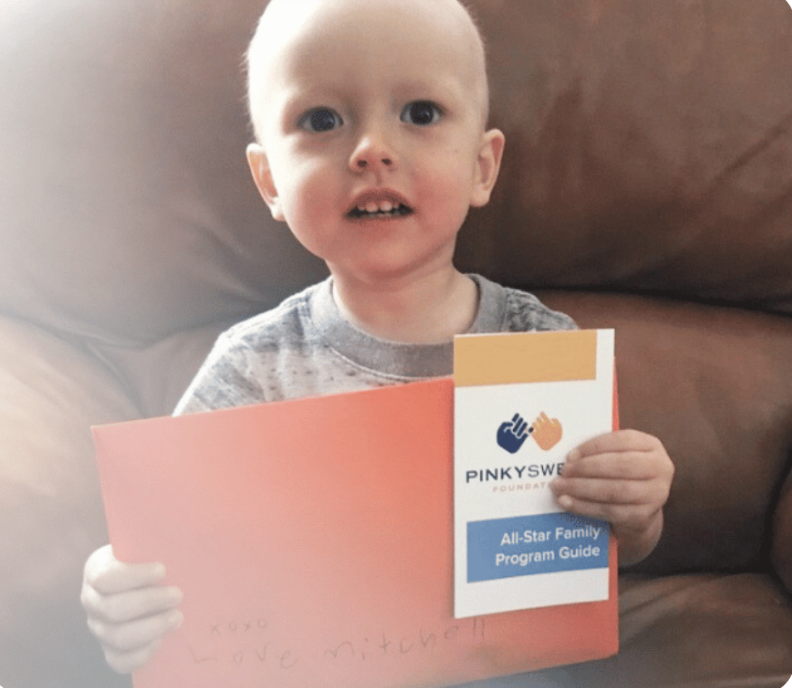
Gabriella Del Rio | Regional Leader: Program Development

